Slide 1


Course: Data Structure​
(Course Code: ETCCDS202 )​
​​
UNIT-1: Foundations of Data Structures​
Dr. Shahjad, Mr. Deepak, Neetu Ma’am​
School of Engineering & Technology
K.R. Mangalam University
Notes:
New Courses replaced with New Programmes

Slide 2

SESSION 6:
Divide & Conquer Paradigm
Notes:
New Courses replaced with New Programmes

Slide 3

Recapitulation (Previous Session)
What is an algorithm?
Which approach tries all possibilities directly? a) Greedy b) Brute Force c) Divide & Conquer
What are the three types of complexity classes
For the functions $F\left(n\right)=n+5$and $T\left(n\right)=n−5$, determine the asymptotic complexity class.
Notes:
New Courses replaced with New Programmes

Slide 4
Recapitulation (Previous Session)
Today we learn:
How large problems are solved efficiently by breaking them into smaller problems.
Notes:
New Courses replaced with New Programmes

Slide 5
Learning Objectives
After this lecture, students will be able to:
Explain the Divide & Conquer approach
Identify problems suitable for Divide & Conquer
Write steps of a Divide & Conquer algorithm
Analyze its time complexity
Apply it to real-world problems
Notes:
New Courses replaced with New Programmes

Slide 6
What is Divide & Conquer?
Definition: Divide & Conquer is an algorithm design technique that:
Divides a problem into smaller subproblems Solves each subproblem
Combines the results to get the final solution
Key idea: “Break → Solve → Combine
Notes:
New Courses replaced with New Programmes

Slide 7
Three Main Steps
Divide & Conquer has 3 steps:
Divide – Break the problem
Conquer – Solve smaller problems
Combine – Merge solutions
Notes:
New Courses replaced with New Programmes

Slide 8
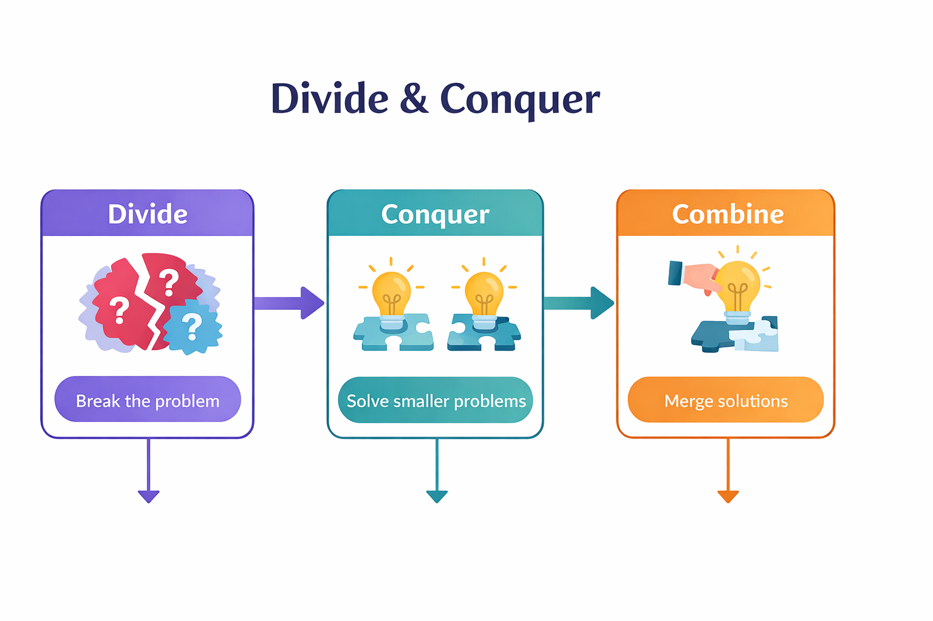
Three Main Steps (Visual-Oriented)
Notes:
New Courses replaced with New Programmes

Slide 9
Real-Life Analogy (Concrete Example)
Example: Searching a word in a dictionary
Do we read page by page?
We split the book into halves
Keep dividing until the word is found
This is Divide & Conquer in real life
Notes:
New Courses replaced with New Programmes

Slide 10
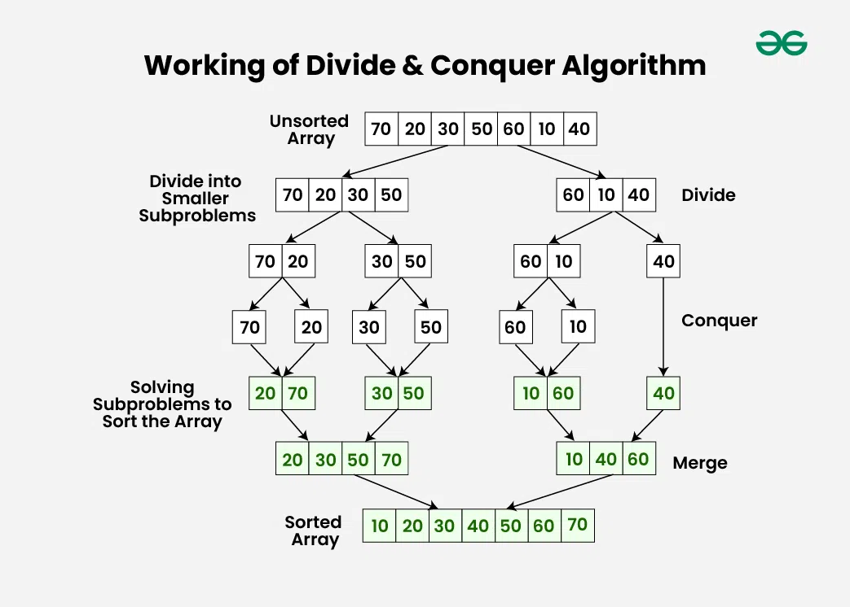
Working Procedure Divide and Conquer
Notes:
New Courses replaced with New Programmes

Slide 11
EXAMPLE 1
Sort the following array using Divide & Conquer:
[38, 27, 43, 3, 9, 82, 10]
Step 1: DIVIDE (Split the array)
[38, 27, 43, 3, 9, 82, 10]
↓
[38, 27, 43] [3, 9, 82, 10]
Split again:
[38, 27] [43] [3, 9] [82, 10]
Split until single elements:
[38] [27] [43] [3] [9] [82] [10]

Slide 12
EXAMPLE 1
Single element = already sorted
Step 2: CONQUER (Solve subproblems)
Each single element is considered sorted.
Step 3: COMBINE (Merge sorted parts)
Merge step by step:
[38] + [27] → [27, 38]
[3] + [9] → [3, 9]
[82] + [10] → [10, 82]
Next level merge:
[27, 38] + [43] → [27, 38, 43]
[3, 9] + [10, 82] → [3, 9, 10, 82]

Slide 13
EXAMPLE 1
Final merge:
[27, 38, 43] + [3, 9, 10, 82]
→ [3, 9, 10, 27, 38, 43, 82]
Visual Tree Representation (Board / Slide)
[38,27,43,3,9,82,10]
/ \
[38,27,43] [3,9,82,10]
/ \ / \
[38,27] [43] [3,9] [82,10]
/ \ / \
[38] [27] [82] [10]

Slide 14
Engineering / Industry Example
Industry Use Case:
Searching data in large databases
Sorting huge datasets (Amazon, Google)
Image processing & signal processing
Divide & Conquer improves speed & scalability

Slide 15
Classical Divide & Conquer Algorithms
Common algorithms using Divide & Conquer:
Binary Search
Merge Sort
Quick Sort
Strassen’s Matrix Multiplication
One algorithm name = one idea (avoid overload)

Slide 16
Worked Example (Binary Search)
Problem: Find element 25 in a sorted array Steps:
Check middle element
Decide left or right half
Repeat until found

Slide 17
Partially Worked Example
Binary Search – Student Completes Steps
Array: 5, 10, 15, 20, 25, 30
Target = 15
Middle = ?
Left or Right?
Think–Pair–Share

Slide 18
Time Complexity Insight
Why Divide & Conquer is efficient?
Problem size reduces each step
Fewer comparisons
Faster than linear methods
Example:
Linear Search → O(n)
Binary Search → O(log n)
Highlight key terms only

Slide 19
Class Activity
Identify Divide, Conquer, Combine in Merge Sort
Which step uses recursion?
✔ Start easy ✔ Teacher guides answers

Slide 20
Common Misconceptions (Correction Slide)
Divide & Conquer ≠ random splitting
Not all problems fit this approach
Works best when subproblems are independent
Immediate misconception correction

Slide 21
Reflection & Independent Practice
Reflection
What did we learn today?
Where can we apply Divide & Conquer?
Homework
Explain Divide & Conquer using a real-life example
Compare Linear Search vs Binary Search

Slide 22
THANK YOU

